Slide 1
Accessing Your Career Portfolio & Saving Your Resume on careerzone.ny.gov Use GOOGLE CHROME to complete this activity

Slide 2
Click on My Portfolio

Slide 3
Log in with your information

Slide 4
Access the Resume Builder

Slide 5
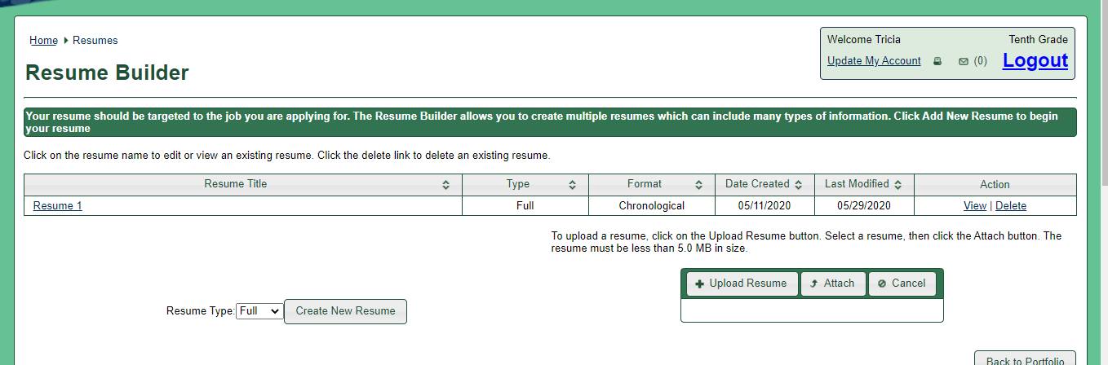
Open Your Resume
Click on the resume that you have created

Slide 6
Next, Open Each Tab
You will be checking each box so your inputted data will display on your resume.

Slide 7
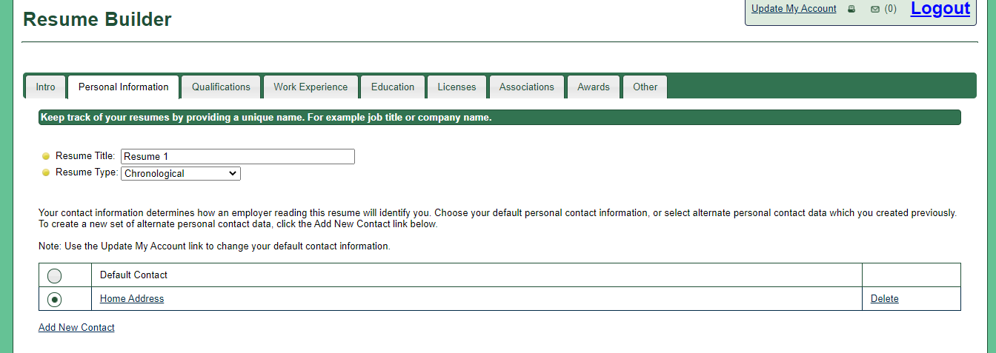
Personal Info. Tab
Click the bullet in front of Home Address
Not default address

Slide 8
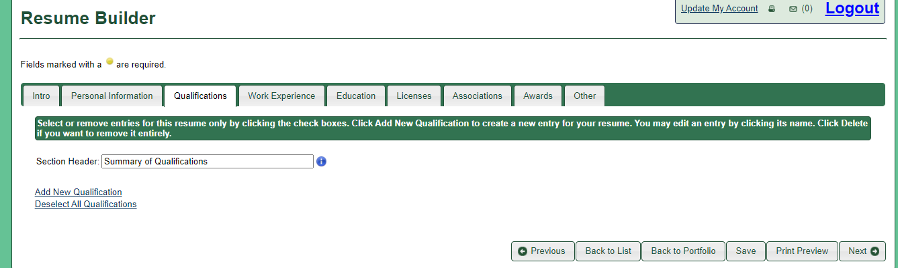
SKIP the Qualifications Tab
Only because we haven’t used this category yet.
It is designed more for your qualifications for a specific job.

Slide 9
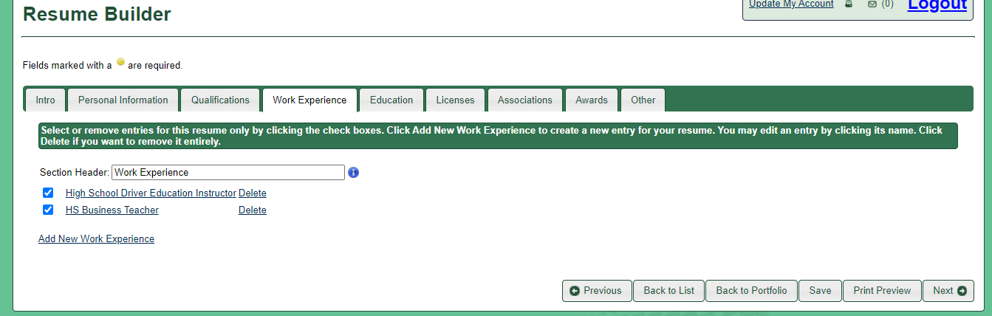
Click on the Work Experience Tab
Check the box in front of each job you have put in so they will show up on your resume.

Slide 10
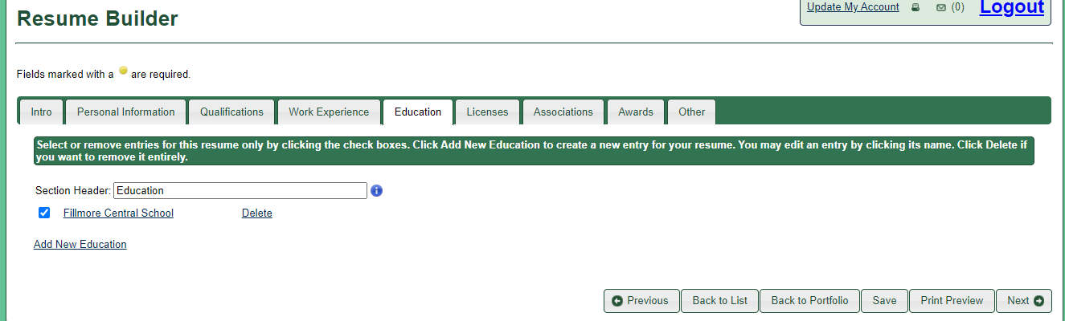
Click on the Education Tab
Click in the box in front of your school so it will show up on your resume.

Slide 11
UNSELECT Licenses
We skipped this section for now
we need to make sure it is not turned on.
Make sure there is no mark in the box

Slide 12
Click on the Associations Tab
Select all boxes you have data included in.

Slide 13
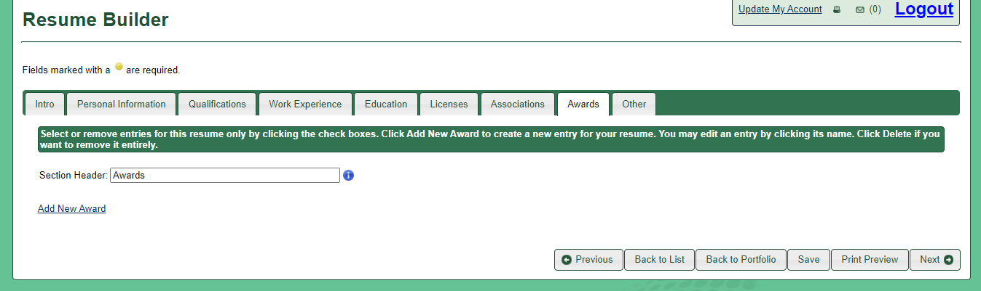
Click on Awards Tab
Click on any area you have inputted information.

Slide 14
Click on Other Tab
Select any information you have added in.

Slide 15
Select Print Preview
This will allow you to see what your resume is starting to look like.

Slide 16
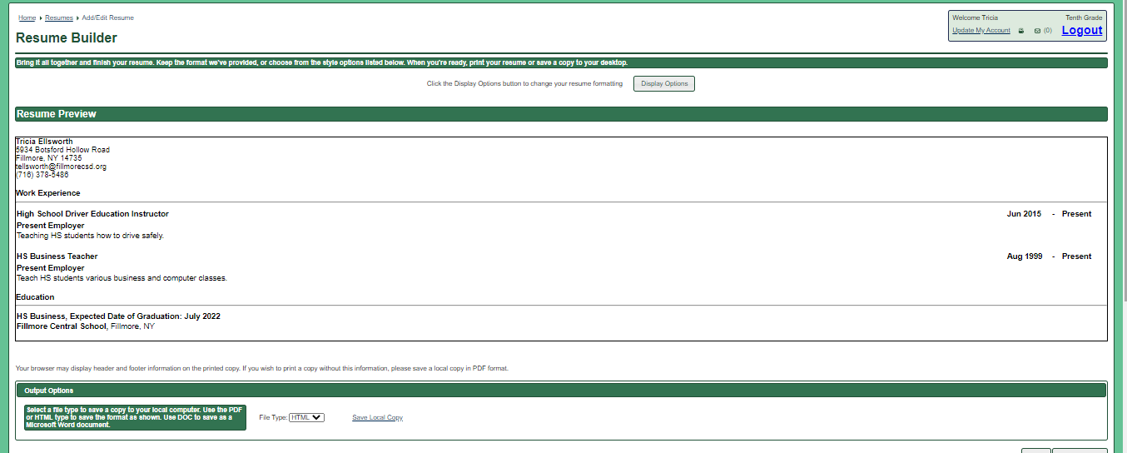
Yay, you did it! This is just a starting point.
You can log in to your Career Portfolio and edit it any time.
This will be a very useful tool for you each time you need a resume.

Slide 17
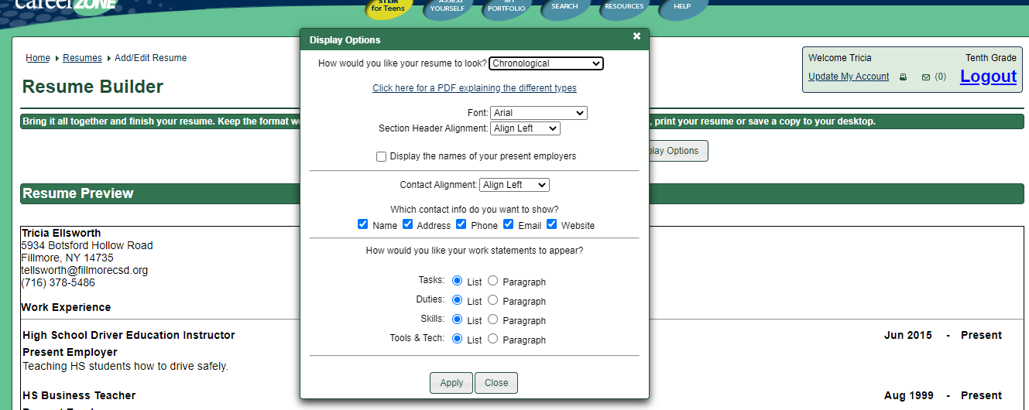
Display Options
Select Display Options
This will allow you to personalize the look of your resume.
You can change your font and layout.
Make your choices and choose apply.

Slide 18
I chose to change my font to Times New Roman

Slide 19
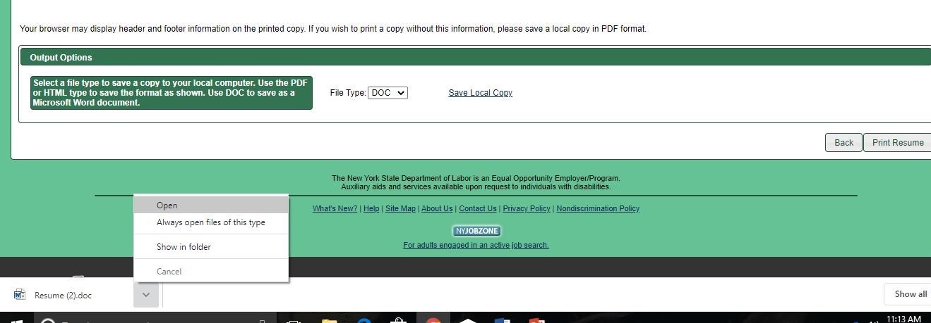
Output Options
At the bottom of the screen you will see a section File Type.
Change HTML to DOC
Click “Save Local.”
Select Open

Slide 20
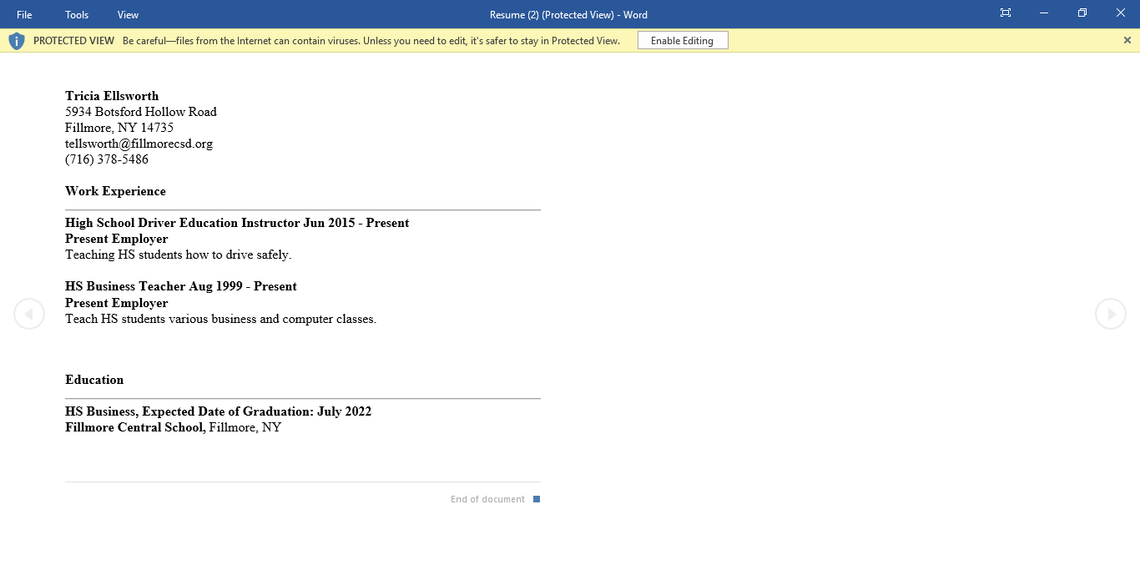
Your resume should open in Word
Click “enable editing” in the yellow bar at the top of the page.
Save to Office 365 as resume
File
Save as
Resume
Email or share this document to me

